Slide 1
Vibe Check 2024
CIS 6905 Progress Update – November 15, 2024
Deeptika Kannan

Slide 2
What happened last time
LDA improved data pipeline and data analysis for full dataset and dataset for each debate
Generated visualizations of key words
Result analysis and interpretation of topics
Faced roadblock of long running times for hyperparameter tuning

Slide 3
What has happened since
Hyperparameter tuning completed
Coherence score reaches 0.56 for the full dataset
Text summarization of debates

Slide 4
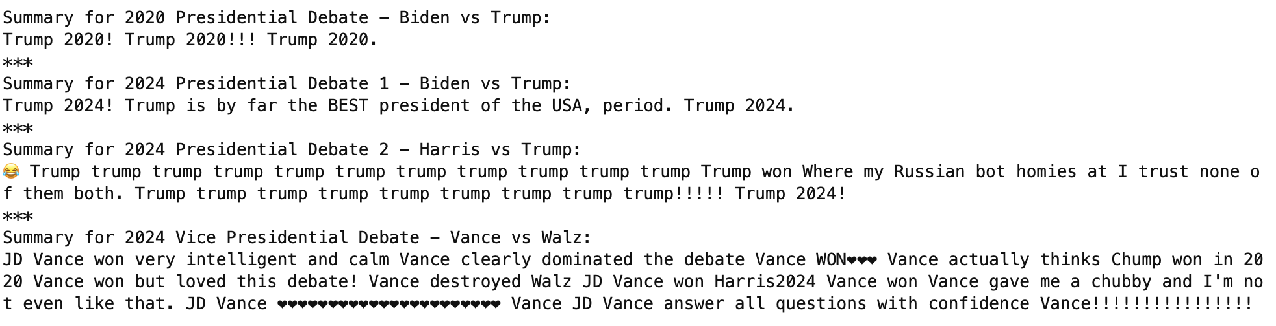
What has happened since
Text summaries show overwhelming support for the Republican party
Interesting especially for the 2nd 2024 presidential debate when we had more left-leaning networks than right-leaning
Output Screenshot:

Slide 5
What has happened since
Analysis of Political Bias in YouTube Comments
Assigned bias scores to news networks (-3 to +3 scale) based on the media bias chart
Negative scores for left-leaning sources and positive scores for right-leaning sources
Converted comments to numerical vectors using TF-IDF
Reduced dimensionality with PCA
Visualized results in a 2D scatter plot
Expected to identify clustering patterns and distributions of comments based on the political leanings of their source networks.

Slide 6
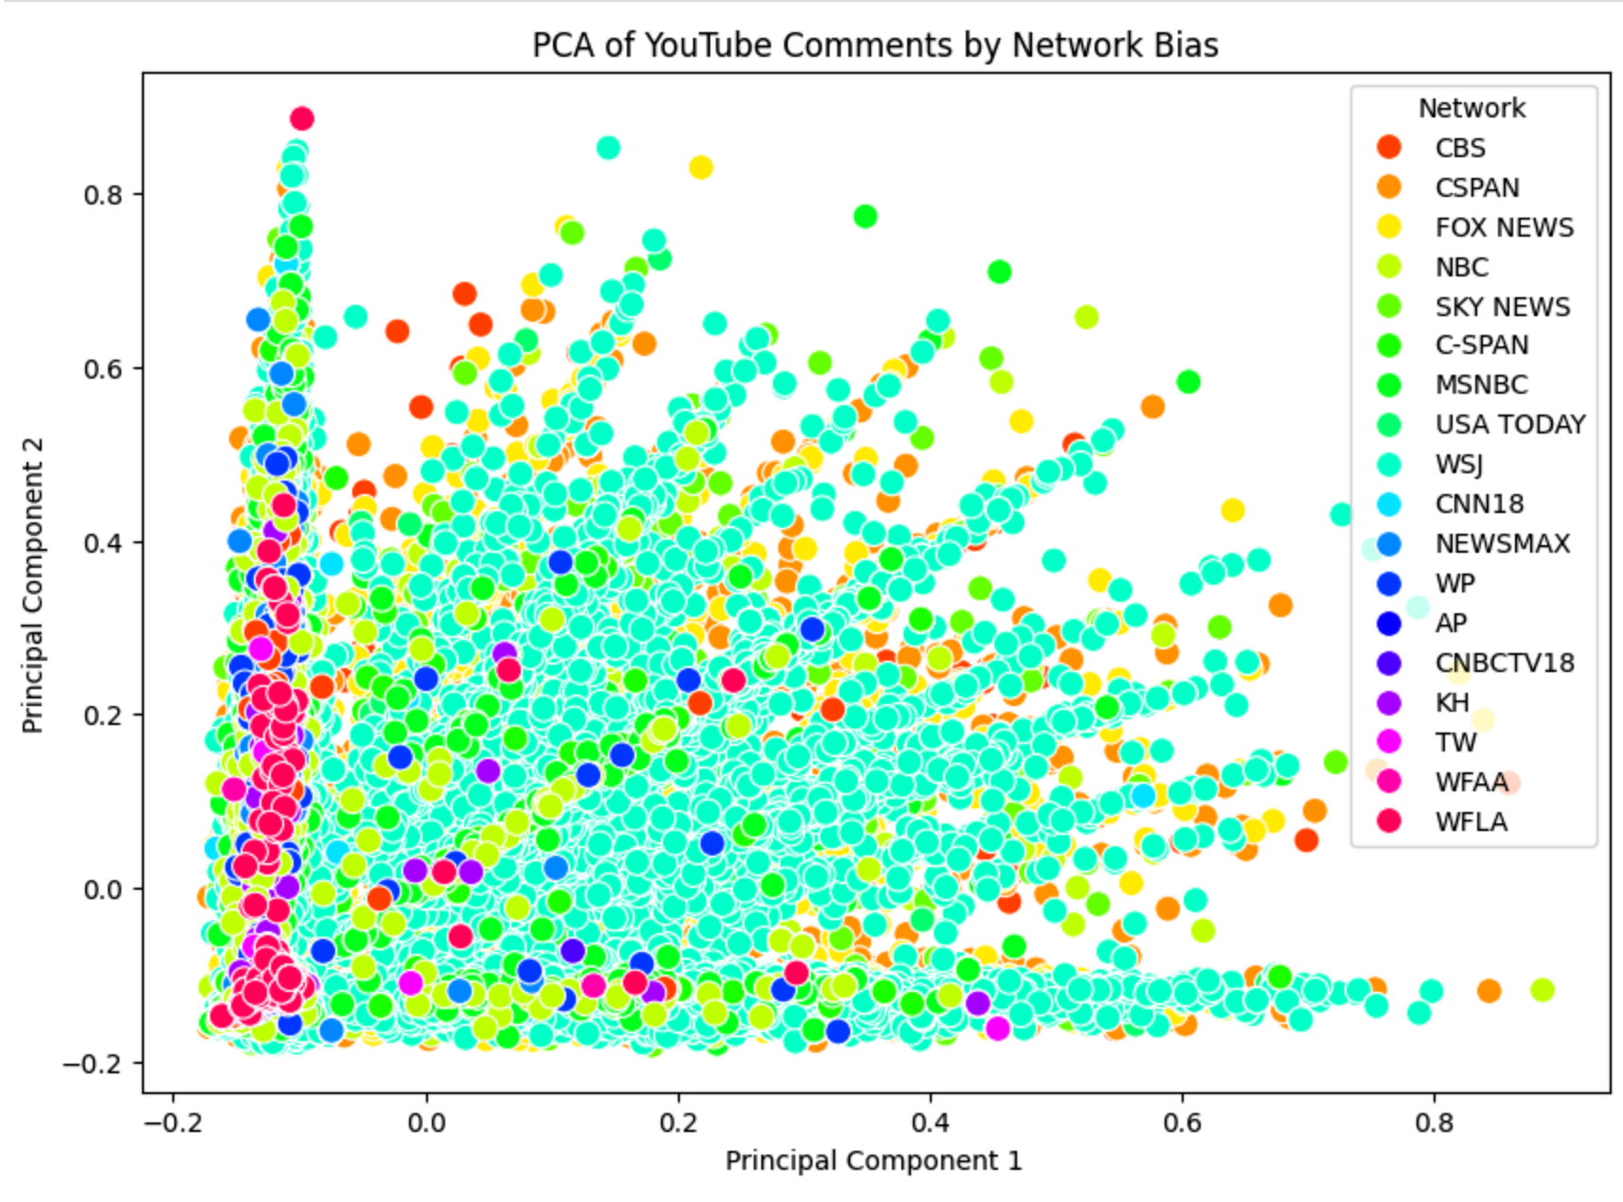
What has happened since
Note: Each point represents a comment, colored by network source in legend

Slide 7
What has happened since
Key Observations:
Wall Street Journal (turquoise) dominates with highest comment volume, showing fan-like spread
Dense clustering near origin (-0.2, 0) suggests common themes across networks
Rightward spread (PC1: 0 to 0.8) indicates topic diversification
Vertical spread (PC2: -0.2 to 0.8) shows varying comment characteristics

Slide 8
What has happened since
Notable Patterns:
No clear ideological separation between left/right-leaning networks
CBS, NBC, FOX show similar distribution patterns
Strong mixing of different colored points suggests shared language patterns
Higher density of comments in lower PC2 values (-0.2 to 0.2)

Slide 9
What has happened since
Insight - Comment content appears more influenced by debate topics than network political bias, suggesting viewers engage with content similarly regardless of their preferred news source

Slide 10
Roadblocks & Future Plans
ROADBLOCK - Long running times for models
I’ve been trying to implement several parallel processing techniques, which took a good chunk of time this week
Future Plans
Other topic modeling approaches
Text summarization
Data visualization for the interface
Better interpretation of comment bias results

